Slide 1

What Has GOD Given Me?
4 Look on my right hand and see, For there is no one who acknowledges me; Refuge has failed me; No one cares for my soul.
5 I cried out to You, O LORD: I said, "You are my refuge, My portion in the land of the living.
6 Attend to my cry, For I am brought very low; Deliver me from my persecutors, For they are stronger than I.
7 Bring my soul out of prison, That I may praise Your name; The righteous shall surround me, For You shall deal bountifully with me."
--Psalm 142
“Come and hear, all you who fear God, And I will declare what He has done for my soul” (Ps. 66:16).

Slide 2

What Has God Given Me?
“Look, I go forward, but He is not there, And backward, but I cannot perceive Him; When He works on the left hand, I cannot behold Him; When He turns to the right hand,
I cannot see Him.”
Job 23:8, 9

Slide 3
What Has God Given Me?
“Surely I have cleansed my heart in vain, And washed my hands in innocence. For all day long I have been plagued, And chastened every morning.”
Psalm 73:13, 14

Slide 4
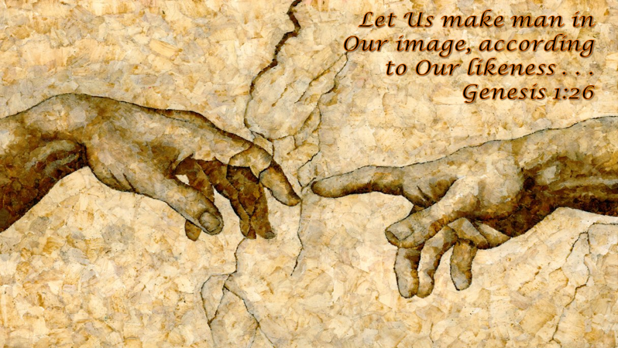
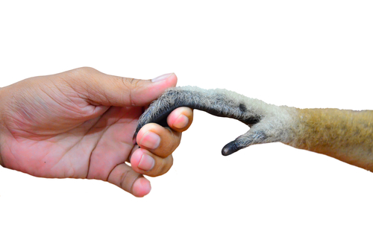
What Has God Given Me?
(1)
God has given me HIS IMAGE Gen. 1:26
Not a glorified animal!
James 3:9, “With it we bless our God and Father, and with it we curse men, who have been made in the similitude of God.”

Slide 5
⁸ First, I thank my God through Jesus Christ for you all, that your faith is spoken of throughout the whole world.
⁹ For God is my witness, whom I serve with my spirit in the gospel of His Son, that without ceasing I make mention of you always in my prayers,
¹⁰ making request if, by some means, now at last
I may find a way in the will of God to come to you.
Romans 1

Slide 6
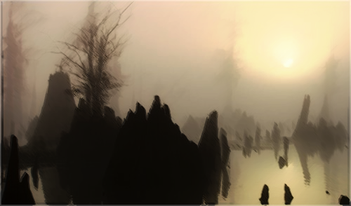
Not EVOLUTION
From A Primordial Pool
This Photo by Unknown Author is licensed under CC BY-NC

Slide 7
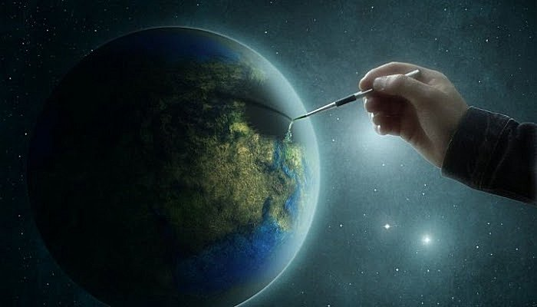
I will praise You, for I am fearfully and wonderfully made; Marvelous are Your works, And that my soul knows very well.
Psalm 139:14

Slide 8
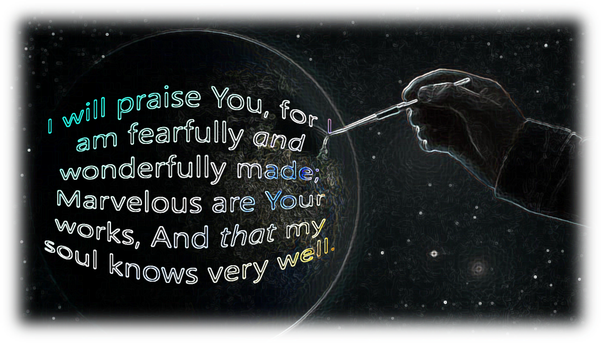
Jeremiah 1:5, “Before I formed you in the womb I knew you; Before you were born I sanctified you;
I ordained you a prophet to the nations.”
I ordained you
I sanctified you
I knew you
I formed you

